Slide 1
SQL (Structured Query Language)
Amos Azaria

Slide 2

SQL (Structured Query Language)
SQL (in SQL server pronounced Seek Well).
A language for executing commands on a database.
Commands are based on Relational Algebra.
Case insensitive language. Convention is to use upper case for all SQL keywords.
One of the very few case insensitive languages still used today. Old programing languages (Fortran, Cobol, Lisp, Basic, Pascal) were case insensitive since they were designed for punched cards, which did not differentiate between lower case and upper case.

Slide 3
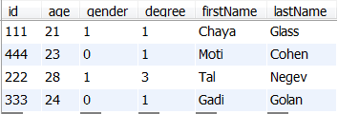
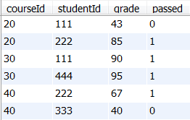

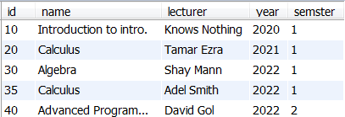
Our tables
students
grades
courses

Slide 4


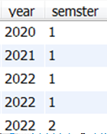
SELECT Command
SELECT id FROM students
SELECT id*2 FROM students
SELECT year, semester FROM courses
SELECT * FROM grades

Slide 5
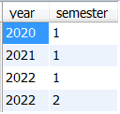
DISTINCT (unique)
SELECT DISTINCT year, semester FROM courses;

Slide 6


WHERE Keyword
SELECT id FROM students WHERE degree < 2
SELECT age FROM students WHERE firstName LIKE '%i'

Slide 7



conditions
>, <, =, <=, >=, <>
AND, OR, NOT
BETWEEN
- SELECT * FROM grades WHERE grade BETWEEN 80 AND 90
IN
- SELECT * FROM grades WHERE studentId IN (111,444)
LIKE
SELECT * FROM students WHERE firstName LIKE 'Chay%'

Slide 8


Nested Queries
SQL is Compositional: The result of a select query is a relation!
SELECT lecturer FROM courses WHERE id NOT IN (SELECT courseId FROM grades)
Write an SQL query that lists all last names of students that failed:
SELECT lastName FROM student WHERE id IN (SELECT studentId FROM grades WHERE passed = 0)
List the lecturers that did not feed any grades yet.

Slide 9

Basic set operations
Number of attributes in both queries must match
UNION
(SELECT id,lastName FROM students WHERE id < 200) UNION (SELECT id,lastName FROM students WHERE id BETWEEN 300 AND 400)
The following are not supported in MySQL but can be easily emulated with equivalent queries:
INTERSECT
EXCEPT
distinct
Can be emulated using "IN"
Can be emulated using "NOT IN"
Notes:
You can omit ()

Slide 10

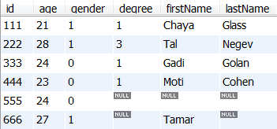

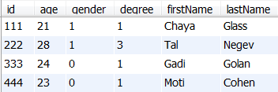
NULL
NULL denotes a missing value.
SELECT * FROM students WHERE lastName IS NULL
SELECT * FROM students WHERE degree = 1 OR degree <> 1

Slide 11
3 Value Logic
SQL expression can evaluate to each of the following truth values:
True
False
Unknown
Any comparison with NULL is evaluated as ‘Unknown’.
This is because a NULL value is assumed to be missing, and unknown.
Even (NULL=NULL) is evaluated as unknown, because each of the values may be different
WHERE (and HAVING) clauses require ‘True’ so ‘Unknown’ is treated as ‘False’.

Slide 12
3 Value Logic Truth Tables
AND | True | False | Unknown
True
False
Unknown
OR | True | False | Unknown
True
False
Unknown
NOT
True
False
Unknown

Slide 13
3 Value Logic Truth Tables (filled)
AND | True | False | Unknown
True | True | False | Unknown
False | False | False | False
Unknown | Unknown | False | Unknown
OR | True | False | Unknown
True | True | True | True
False | True | False | Unknown
Unknown | True | Unknown | Unknown
NOT
True | False
False | True
Unknown | Unknown

Slide 14
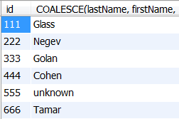
COALESCE
COALESCE(val1, val2, val3 …): returns the first value that is not NULL
SELECT id, COALESCE(lastName, firstName, 'unknown') FROM students

Slide 15
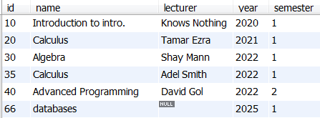
INSERT INTO
Inserting new rows to a table:
- INSERT INTO courses (id,name,lecturer,year,semester) VALUES (66, 'databases', null, 2025, 1);

Slide 16
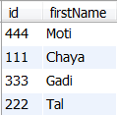
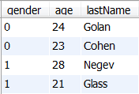
ORDER BY
SELECT id,firstName FROM students ORDER BY lastName
SELECT gender,age,lastName FROM students ORDER BY gender ASC, age DESC

Slide 17



LIMIT
SELECT * FROM students LIMIT 2;
SELECT * FROM students ORDER BY firstName LIMIT 2;
SELECT * FROM students ORDER BY firstName LIMIT 2, 2

Slide 18
Aggregate Functions
Number of rows in the table
SELECT COUNT(*) FROM students
SELECT AVG(grade) FROM grades
SELECT SUM(passed) FROM grades
SELECT MAX(grade) FROM grades
SELECT MIN(grade) FROM grades
Notes:
COUNT(*) returns the number of rows in the table even if we have a row with all null (in case we don't have a PRIMARY KEY)

Slide 19

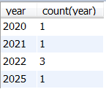

GROUP BY
Suppose we want to know how many courses we have every year:
SELECT year, COUNT(year) FROM courses
SELECT year, COUNT(year) FROM courses GROUP BY year
SELECT name, COUNT(lecturer) FROM courses GROUP BY semester
Picks a (random) entry from each group
Only 4 in semester 1 because we count lecturer, and one of them is NULL.

Slide 20


GROUP BY (cont.)
Write a query that returns the average grade for every course:
SELECT courseId, AVG(grade) FROM grades GROUP BY courseId
Write a query that returns the maximum grade for every student:
SELECT studentId, MAX(grade) FROM grades GROUP BY studentId

Slide 21
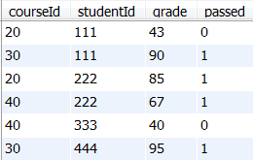


HAVING
HAVING is a condition on the group.
SELECT year, COUNT(year) FROM courses GROUP BY year HAVING COUNT(year) > 1
WHERE vs. HAVING:
WHERE is done before the grouping and HAVING is done after it
E.g. courses in which the average grade of students who passed is under 70:
SELECT courseId,AVG(grade) FROM grades WHERE passed > 0 GROUP BY courseId HAVING AVG(grade) < 70;
Exempli Gratia
Notes:
E.g. comes from latin: Exempli Gratia

Slide 22
Query execution order
SELECT DISTINCT courseId, AVG(grade) FROM grades WHERE passed > 0 GROUP BY courseId HAVING AVG(grade) < 70 ORDER BY courseId, LIMIT 2;
We first look at the FROM part to know which table we want (or joined tables – see next slides).
Then the WHERE predicate to know which rows we are interested in.
Then the GROUP BY.
Then the HAVING.
Then we look at the SELECT to know which columns to show.
Then the DISTINCT removes identical rows
The ORDER BY sorts the results
The LIMIT presents only the requested rows

Slide 23
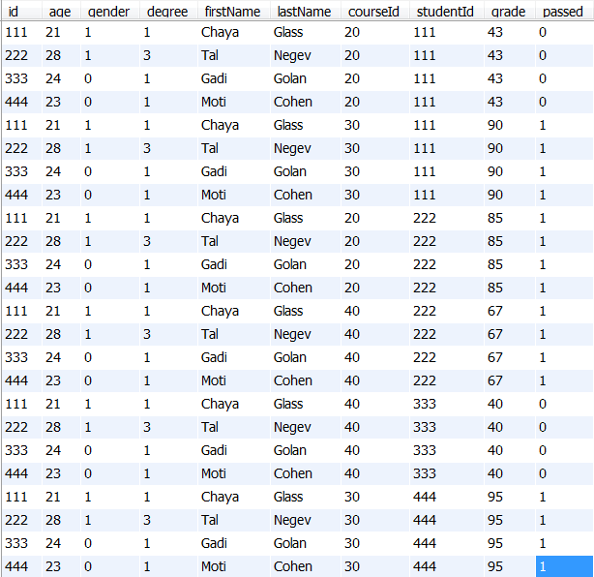
students x grades
SELECT * FROM students, grades

Slide 24
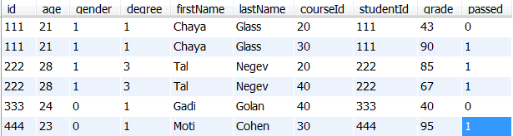
INNER JOIN
Suppose we want to get students full information (not just ids) with their grades
SELECT * FROM students, grades WHERE students.id = grades.studentId
SELECT * FROM students INNER JOIN grades ON students.id = grades.studentId
Notes:
http://stackoverflow.com/questions/2241991/in-mysql-queries-why-use-join-instead-of-where
SELECT * FROM students INNER JOIN grades WHERE students.id = grades.studentId - works
SELECT * FROM students, grades WHERE students.id = grades.studentId - works
SELECT * FROM students, grades ON students.id = grades.studentId – Error!
You can also have several joins one after another: SELECT * FROM students INNER JOIN grades on students.id = grades.studentId INNER JOIN courses on grades.courseId = courses.id

Slide 25
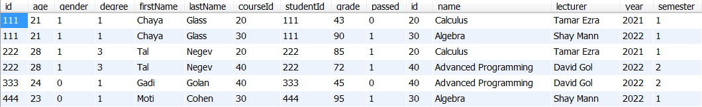
Multiple consecutive joins
SELECT * FROM students INNER JOIN grades on students.id = grades.studentId INNER JOIN courses on grades.courseId = courses.id
Notes:
https://stackoverflow.com/questions/29095281/how-to-select-all-the-columns-of-a-table-except-one-column/46108719

Slide 26
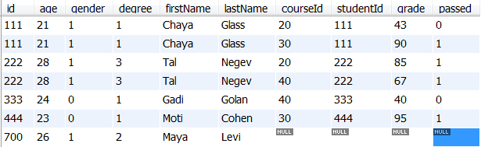
LEFT OUTER JOIN
When using left outer join, all rows FROM left table appear in the result, even if they have no match (they match nulls).
INSERT INTO students (id, age, gender, degree, firstName, lastName) VALUES (700, 26, 1, 2, 'Maya', 'Levi');
SELECT * FROM students INNER JOIN grades ON students.id = grades.studentId
SELECT * FROM students LEFT JOIN grades ON students.id = grades.studentId
A new student has just joined!

Slide 27
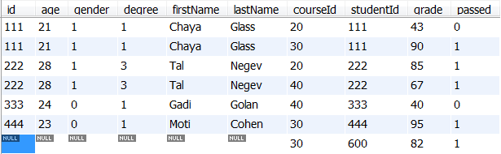
RIGHT OUTER JOIN
We have a new grade for an unregistered student…
INSERT INTO grades (courseId, studentId, grade, passed) values (30, 600, 82, 1);
SELECT * FROM students RIGHT JOIN grades ON students.id = grades.studentId

Slide 28
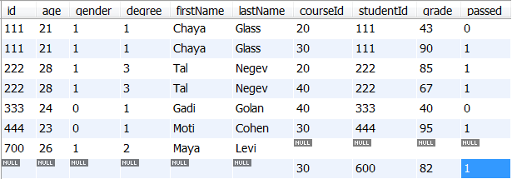
FULL OUTER JOIN
MySQL doesn't support full outer join, but this can be accomplished by uniting a LEFT JOIN with a RIGHT JOIN:
(SELECT * FROM students LEFT JOIN grades ON students.id = grades.studentId) UNION (SELECT * FROM students RIGHT JOIN grades ON students.id = grades.studentId)

Slide 29
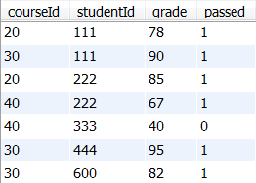
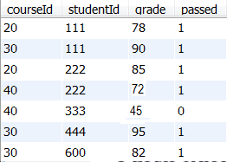
UPDATE
UPDATE grades SET grade=78, passed=1 WHERE studentId=111 AND courseId = 20
SELECT * FROM grades
UPDATE grades SET grade=grade+5 WHERE courseId=40

Slide 30
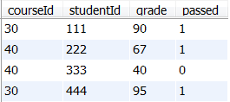
DELETE
DELETE FROM grades WHERE studentId=600 OR courseId=20
(3 rows affected)
SELECT * FROM grades:

Slide 31
CRUD
Basic 4 operations on data:
Create: INSERT (CREATE)
Read: SELECT
Update: UPDATE (ALTER)
Delete: DELETE (DROP)

Slide 32
CREATE TABLE
Creating a table is usually done using the GUI, but can also be done using the command-line.
A pet table in a veterinarian DBMS:
CREATE TABLE pet (name VARCHAR(20), owner VARCHAR(20), species VARCHAR(20), sex CHAR(1), birth DATE);
CHAR(X) – Will always consume X bytes.
VARCHAR(x) – Will consume as many bytes as the input (+1) upto x
TEXT – up-to 65K chars
LONGTEXT – over 4GB
Additional SQL types:
INT
REAL: float/double
BOOLEAN
XML
DATETIME – e.g. '2015-05-21 23:28:01'
See more at: https://www.techonthenet.com/mysql/datatypes.php

Slide 33
Keys
PRIMARY KEY: a column or set of columns that identify the entry (may not be NULL). E.g., id in the students table, or the columns of studentId and courseId in the grades table.
UNIQUE KEY: unique but may be NULL, e.g., a passport number column (not everyone has a passport, but no two people have the same passport number).
INDEX (or just KEY): allows faster indexing. We will usually define as indexes attributes that are likely to be used in joins or appear in the WHERE clause (e.g., lastName). Indexes improve the DBMS's performance as it won't need to read all entries in order to gather those satisfying the condition (e.g., all students whose last name is 'Cohen').
All Keys are stored in B-trees (or hash-indexes).
We will discuss keys in detail when we talk about normalization.

Slide 34
CREATE TABLE (with keys)
PRIMARY KEY and UNIQUE can appear right after type
CREATE TABLE pet2 (int INT PRIMARY KEY, name VARCHAR(20), ownerId INT NOT NULL, species VARCHAR(20), sex CHAR(1), birth DATE, INDEX(ownerId));
Note: NOT NULL
INDEX (or KEY) must be defined after a comma
Notes:
PRIMARY KEY and UNIQUE can also be defined by: PRIMARY KEY(petId)

Slide 35
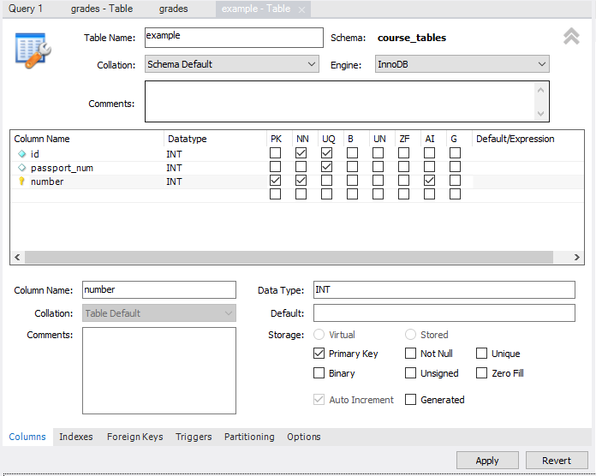
Not Null
PRIMARY KEY
Auto Increment
UNIQUE KEY

Slide 36
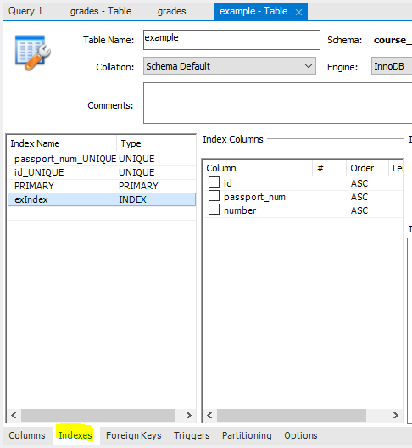

Slide 37
Integrity Constraints
CHECK keyword:
CHECK (country IN ('USA’, 'UK’, 'Israel’, 'India’))
CREATE TABLE people (ID int PRIMARY KEY, lastName varchar(100) NOT NULL, firstName varchar(100), Age int, CHECK (Age>=18));
INSERT INTO people (id, lastName, firstName, age) VALUES (4324, 'Bow', 'Gil', 15);
CREATE TABLE WorkingDay (work_day DATE, income REAL, expenses REAL, revenue REAL, CHECK(revenue=income-expenses));
INSERT INTO WorkingDay (work_day, income, expenses, revenue) VALUES (SYSDATE(), 200, 100, 50);
Notes:
The second type is not likely to be used because it makes the data redundant (we will talk about this later)
שלמות
Supported from version: 8.0.16

Slide 38
Foreign Key
A foreign key is used to link two relations
A foreign key is one field (or more) in one table that is a Primary key in another table.
E.g. The field ‘studentId’ in “grades” table is a foreign key for the field ‘id’ in “students” table
students
grades

Slide 39
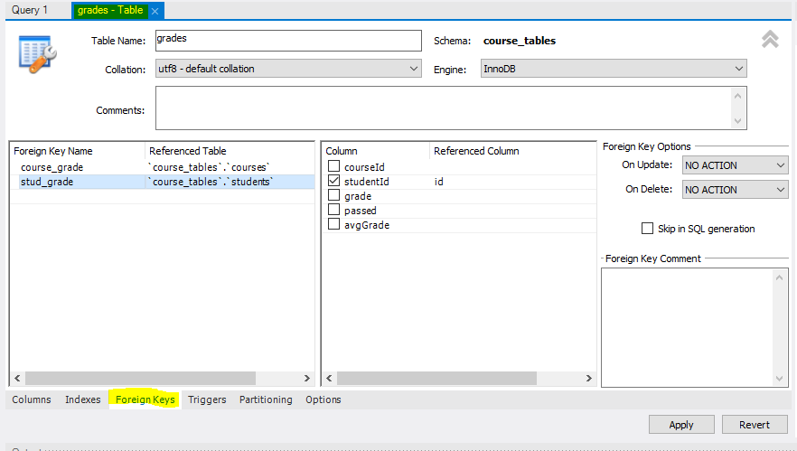
Foreign Key

Slide 40


Foreign Key
students
INSERT INTO grades (courseId, studentId, grade, passed) VALUES ('40', '123', '99', '1’);
INSERT INTO grades (courseId, studentId, grade, passed) VALUES ('40’, ‘444', '99', '1’);

Slide 41
DROP TABLE
DROP TABLE deletes a table:
DROP TABLE pet2
[DELETE TABLE pet2 – returns an error, since DELETE is used to remove entries (rows), with the following syntax: DELETE … FROM …]

Slide 42
ALTER
The command ALTER is used to modify a table:
ALTER TABLE pet ADD death DATE
ALTER TABLE pet DROP death

Slide 43
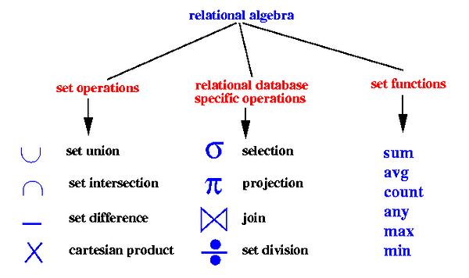
Relational Algebra
Relational algebra defines commands similar to those found in SQL (unfortunately with different names). Each command has a symbol.
WHERE
Left join
Emulated using IN
Right join
SELECT
Emulated using NOT IN
Full outer join
Not supported in SQL but can be emulated

Slide 44
Relational Algebra Examples
SELECT firstName, id FROM students WHERE degree > 1
SELECT students.lastName, students.id, grades.grade FROM students RIGHT JOIN grades ON students.Id=grades.studentId WHERE grades.courseId=20;

